Slide 1


Slide 2
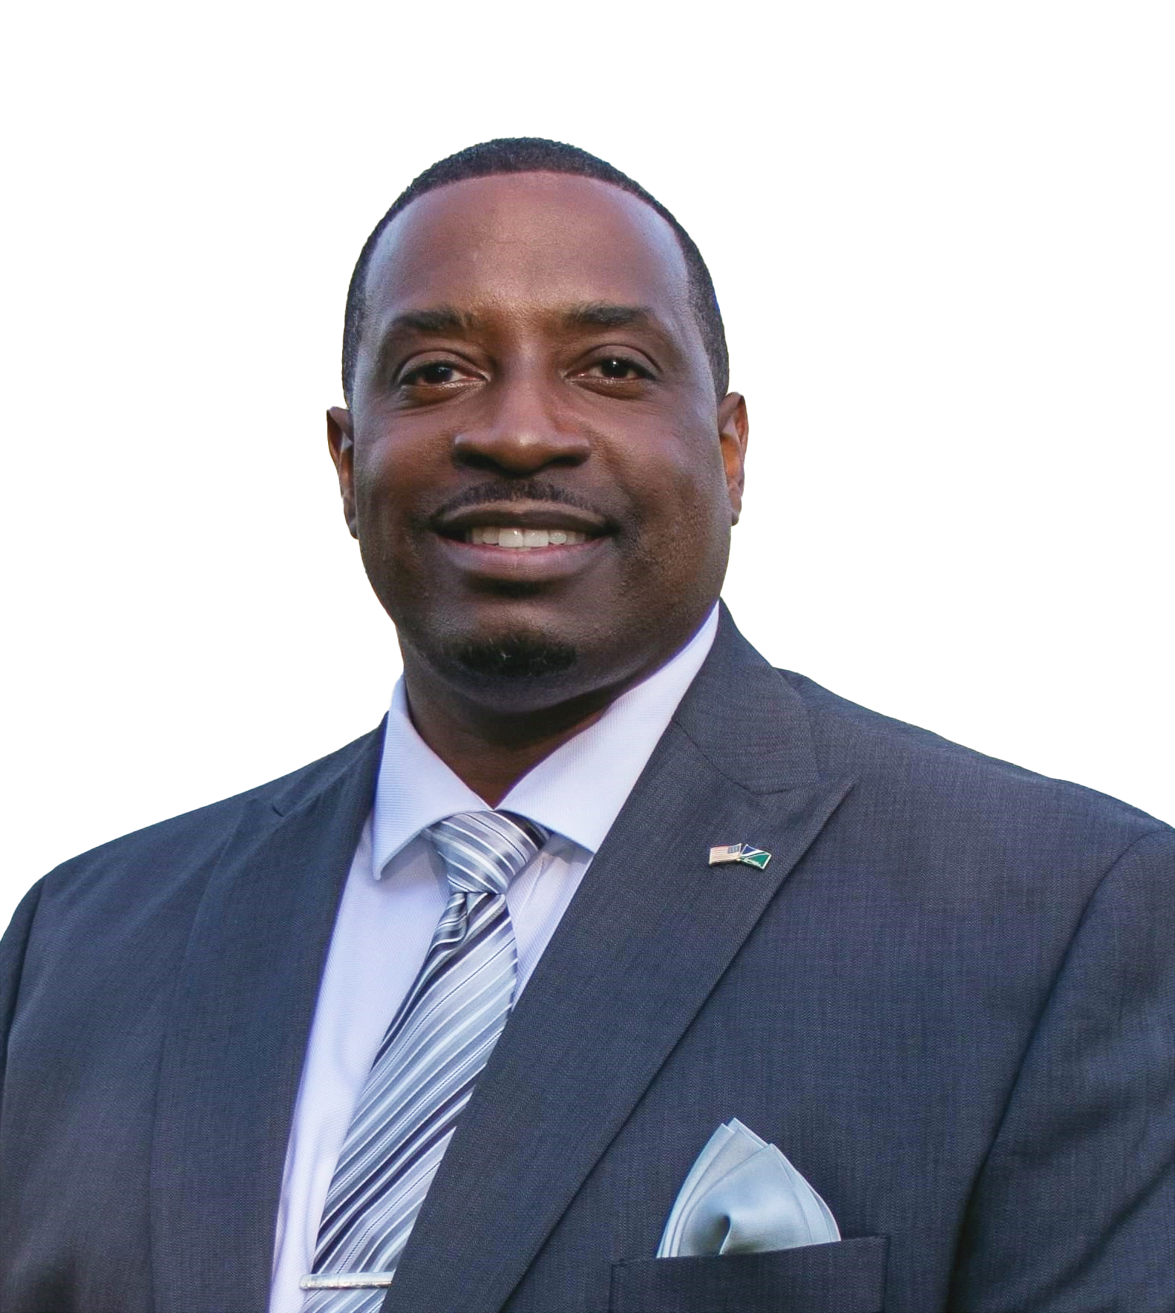
Kick-off &
Introduction of Emcees
SHELDON WATTS, ACE FOUNDER

Slide 3
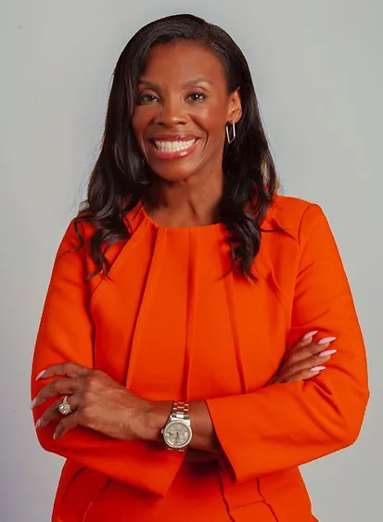
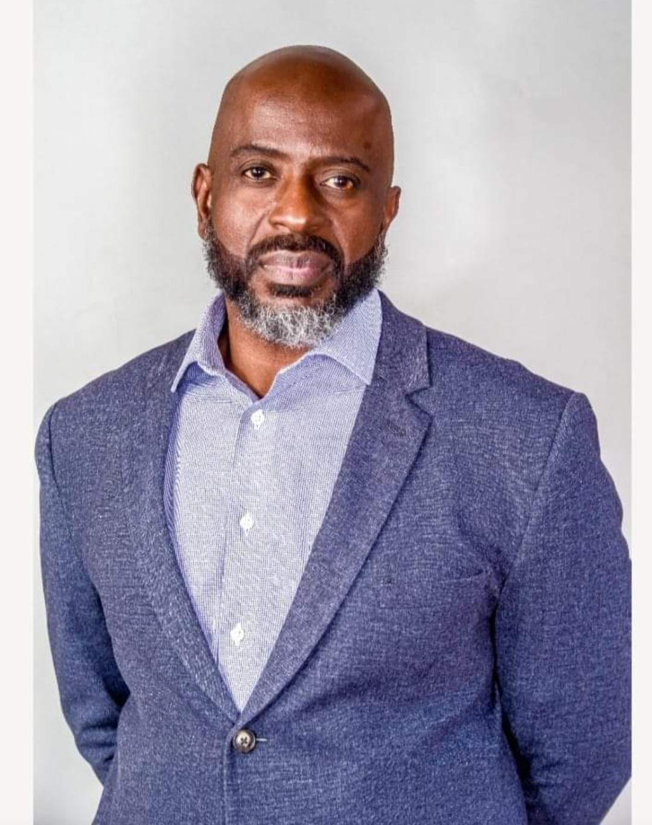
Emcees Welcome
Darlene Hill & Atiba Buchanan
& Introduction of the Black National Anthem

Slide 4
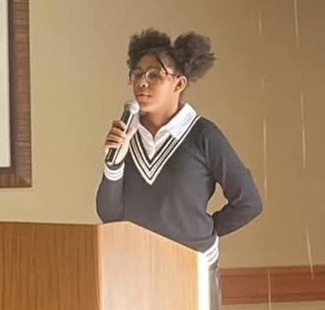
Black National Anthem
"Lift Every Voice and Sing"
- Judea Martin

Slide 5
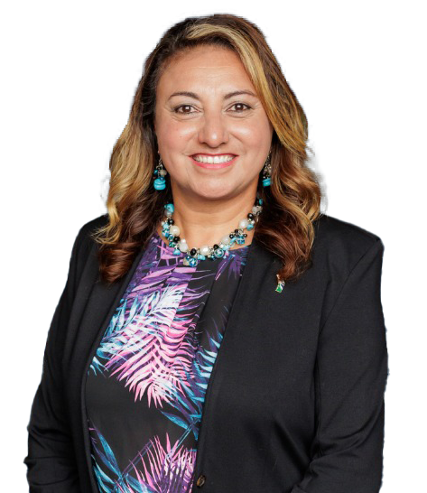
Greetings from the
Mayor of Bolingbrook
Mary Alexander - Basta

Slide 6

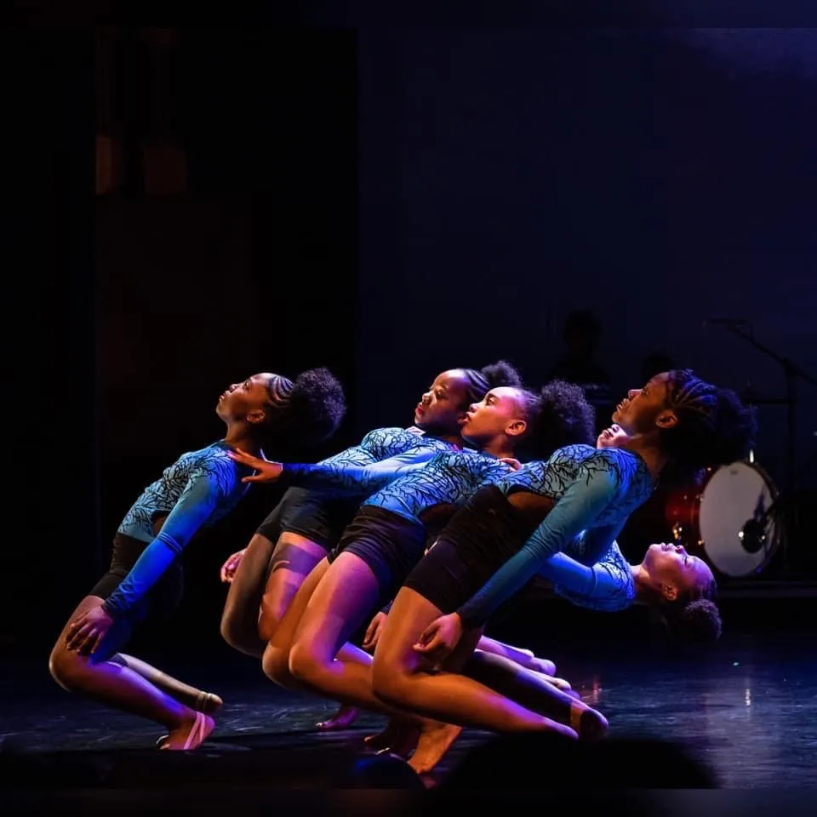
Dance Performance
Praize Productions

Slide 7

Marc Wallace,
"The Wealth Trainer"
Economic Insight - The Relationship Between Civic Engagement and Economic Prosperity

Slide 8
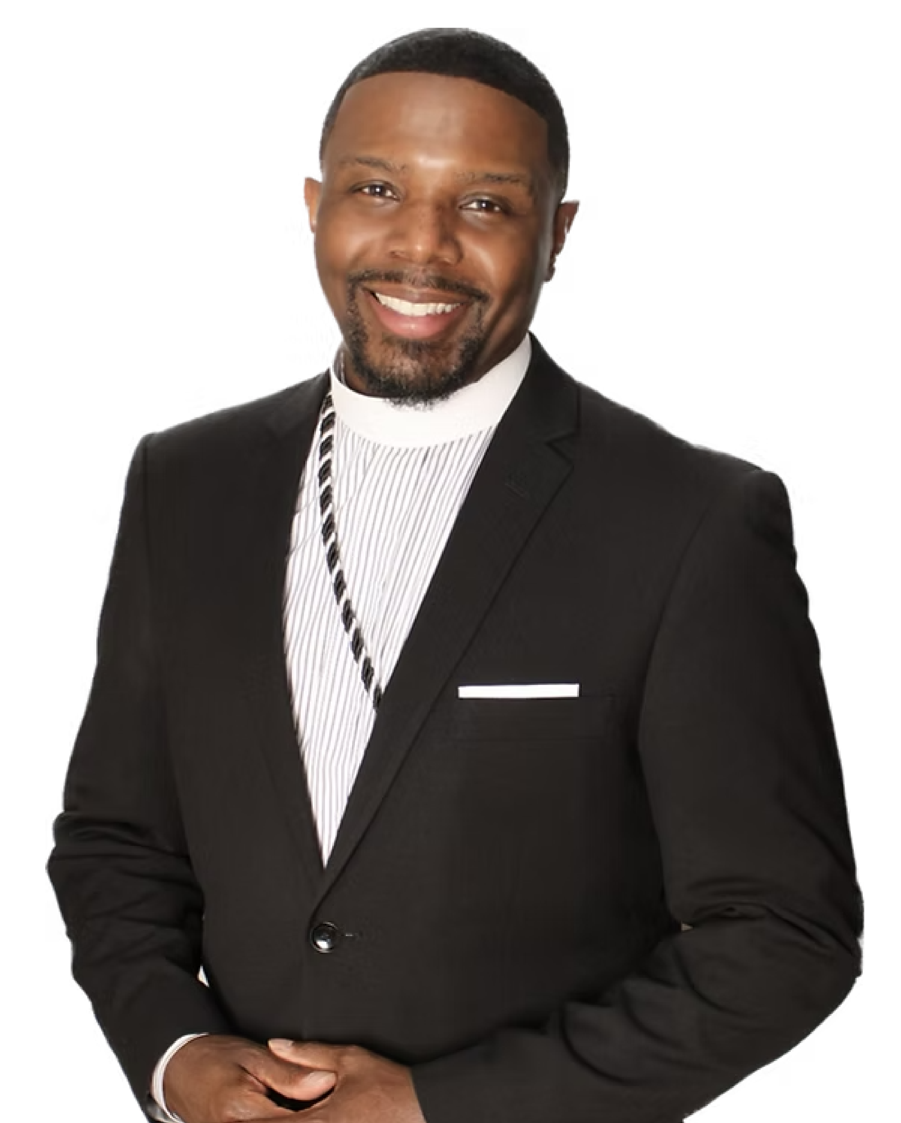
Pastor Dwayne Barefield
All Nations COGIC - Joliet, IL
Opening Prayer / Blessing of the Food

Slide 9
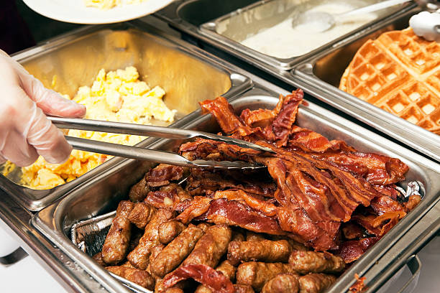

Enjoy Brunch!
Enjoy the delectable brunch prepared by the talented chefs of the Bolingbrook Golf Club!

Slide 10
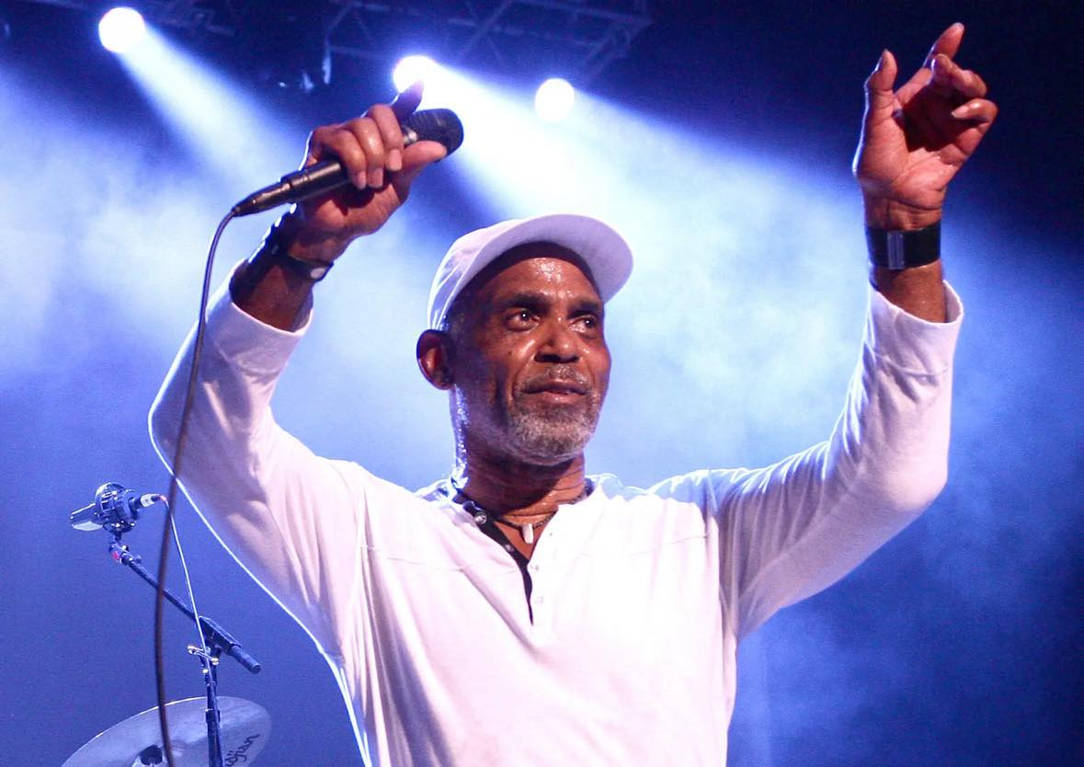
Frankie Beverly Tribute
A consistent hit-maker on the R&B charts for almost 50 years!
December 6, 1946 - September 10, 2024

Slide 11
Sheldon Watts
Founder's Remarks

Slide 12
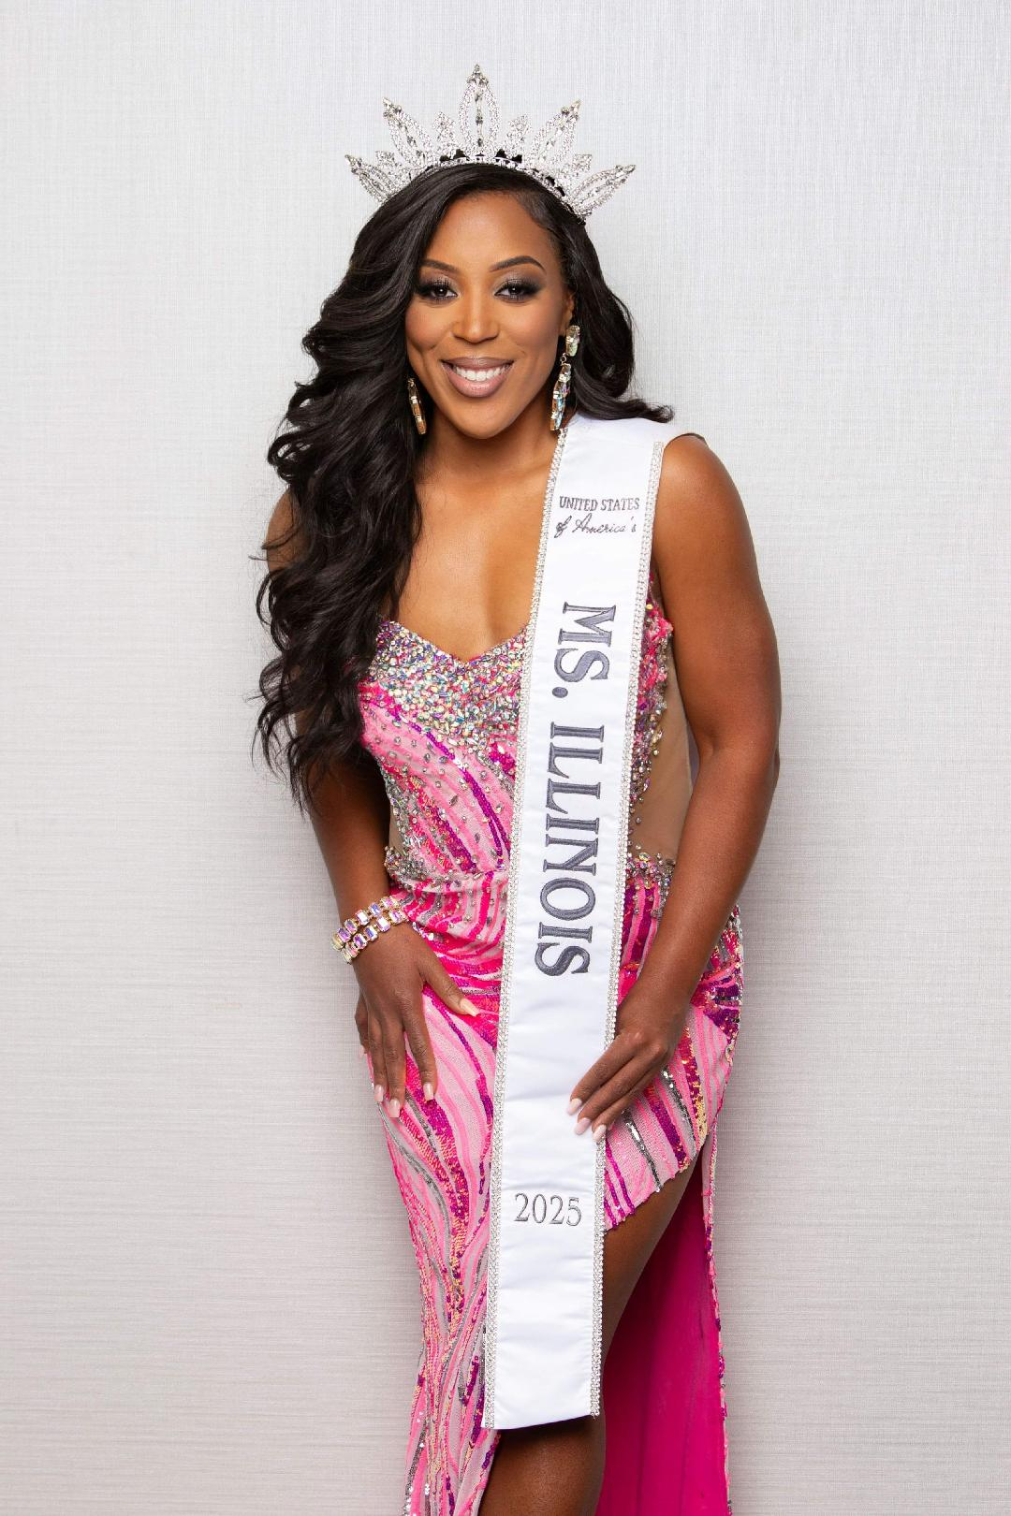
A Person You Should Know
Dr. Brittany Joy Ramsey
Ms. United States of America
Dr. Brittany Joy Ramsey, aka MsFitBritt, The Toning & Muscle Mindset Coach, with over a decade of experience as a Physique Toning Expert, Figure Bodybuilding Pro, and Keynote Motivational Speaker.

Slide 13

EVENT SPONSORS

Slide 14

Champion Sponsor Remarks
Broadview Park District

Slide 15
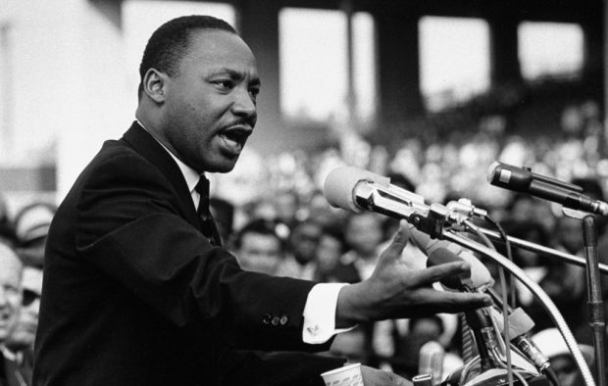
Video Montage #1
"The Life and Legacy of
Dr. Martin Luther King Jr."

Slide 16
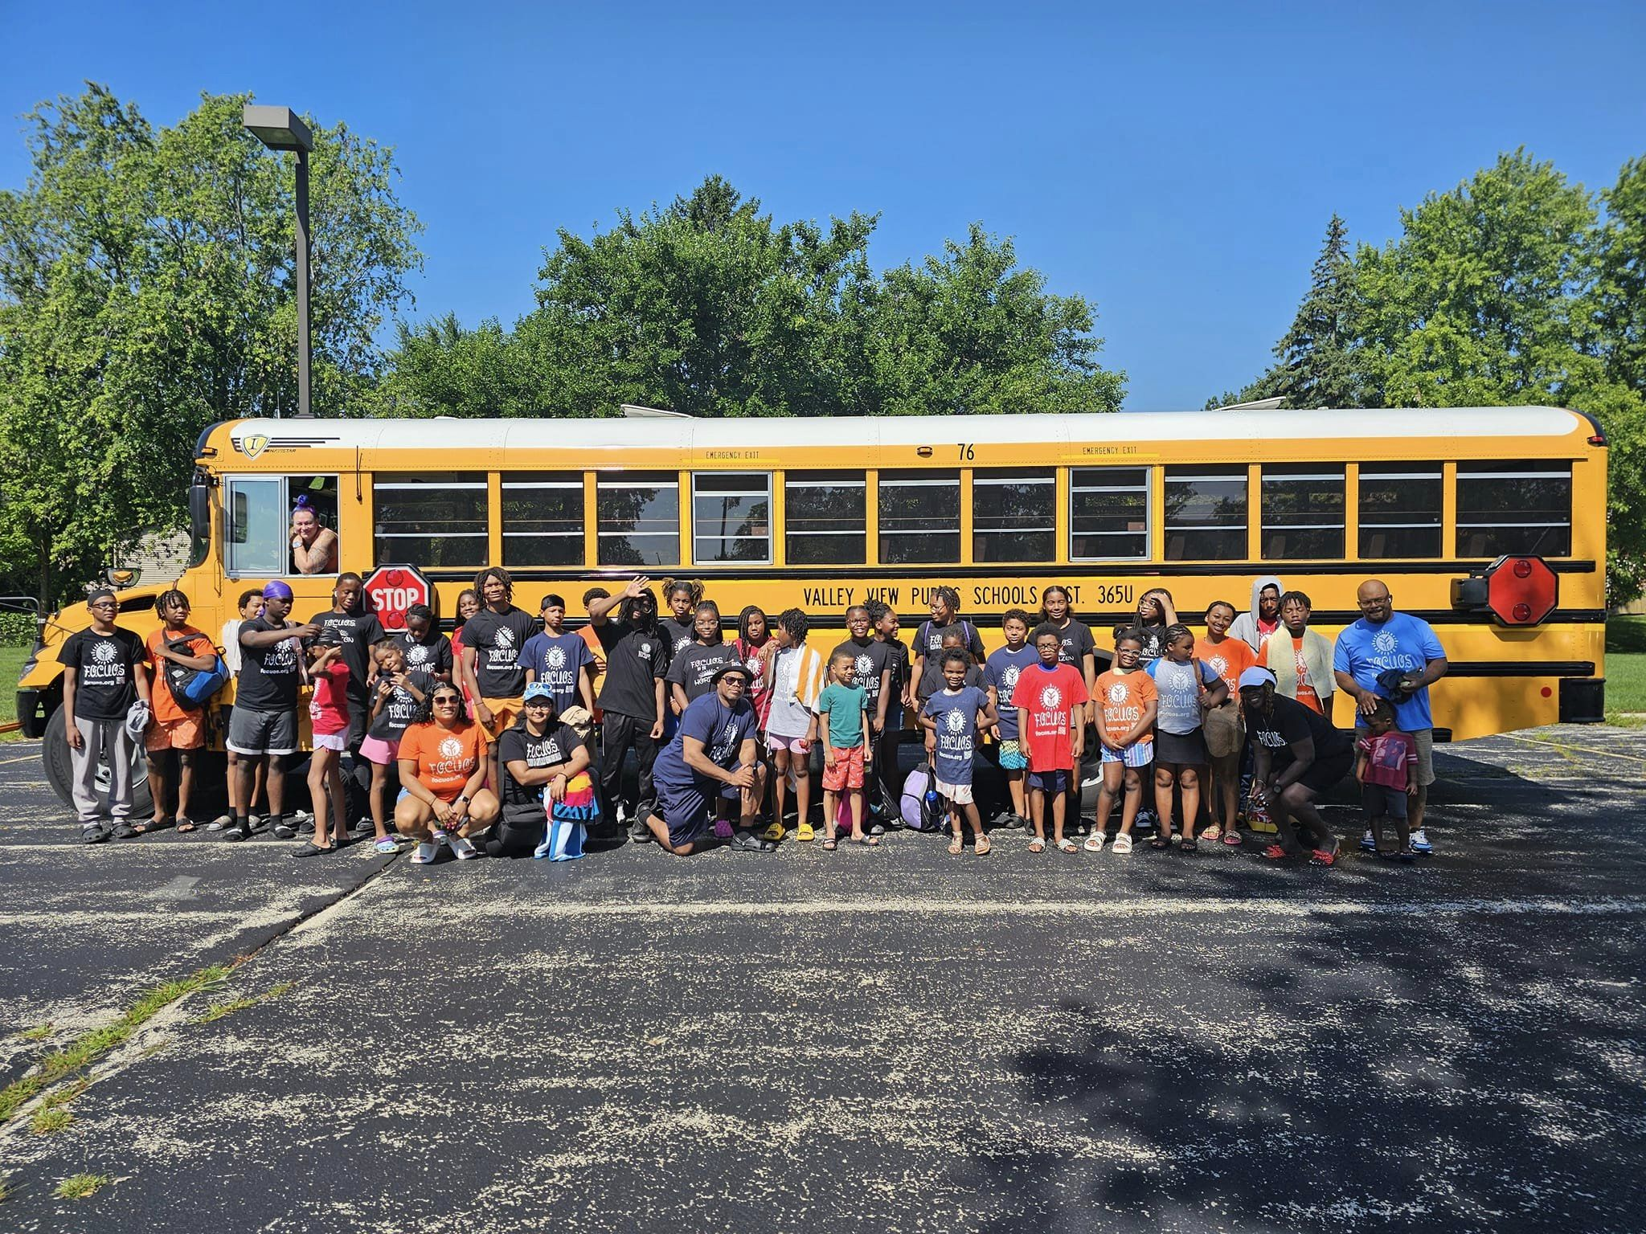
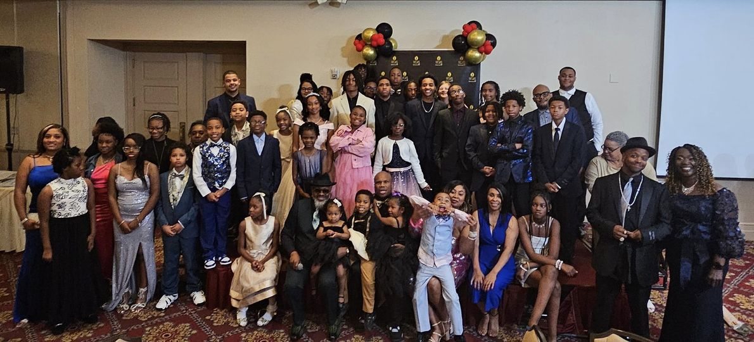
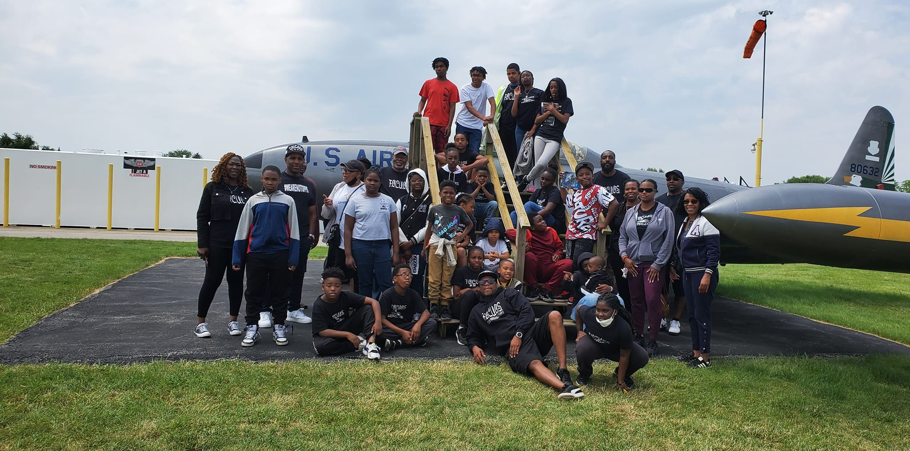
Presentation
F.O.C.U.O.S Youth Organization

Slide 17
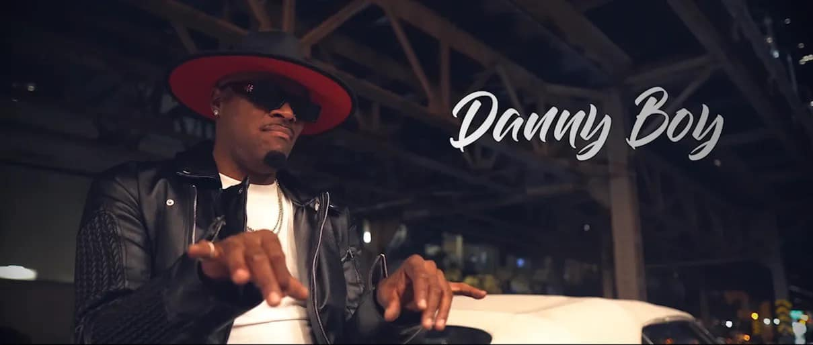
Tribute to MLK
Happy Birthday!

Slide 18

Alliance for Civic Engagement (ACE)
Dr. MLK Jr. Day Unity Brunch
Award Presentations
Youth Trailblazer Award
Excellence in Public Safety Award
Ruby Lofton Community Impact Award

Slide 19
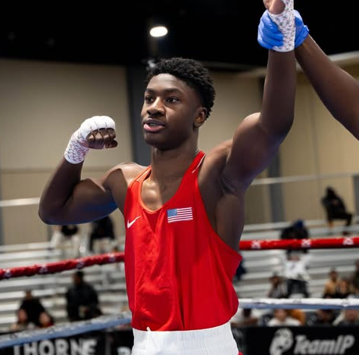
Dr. MLK Jr. Day Unity Brunch Award Presentations
Youth Trailblazer Award
The ACE Youth Trailblazer Award is presented in recognition and celebration of the outstanding achievements, accomplishments, and exceptional leadership displayed by a young visionary in the community. ACE is honored to highlight the award recipient's exceptional qualities that blazes the trail for others to follow and exemplifies the values that Dr. King stood for.
Award Presented to: Joseph "JoJo" Awinongya

Slide 20
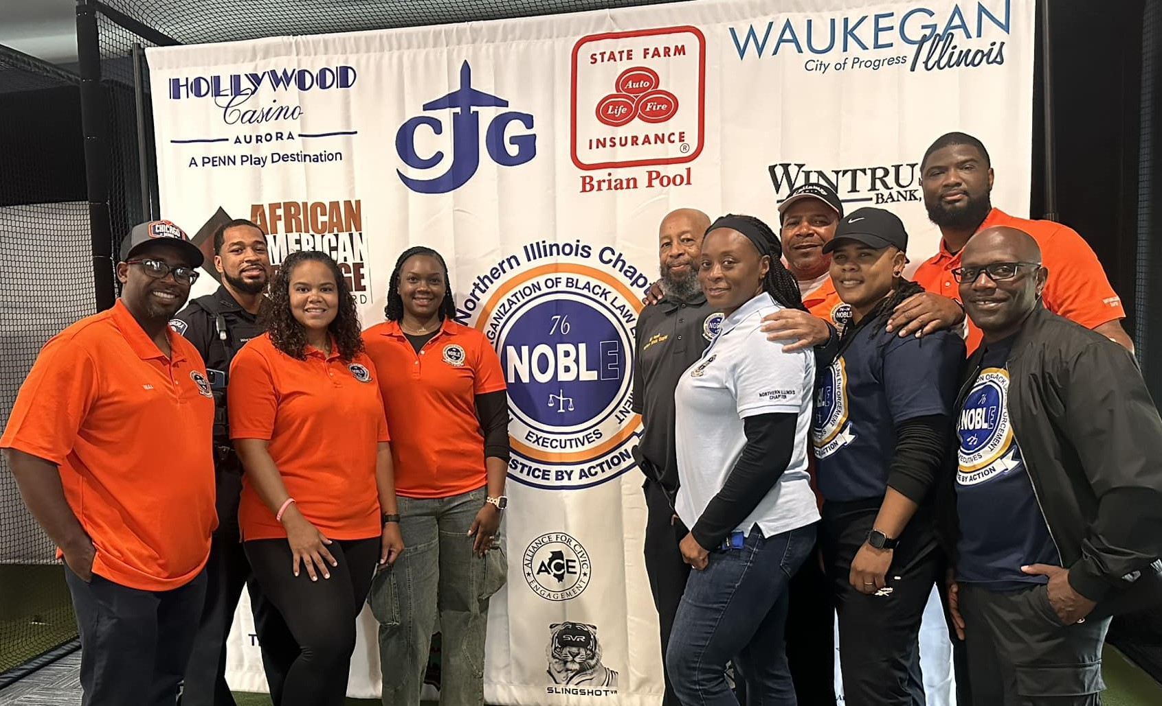

Champion Sponsor Remarks
N.O.B.L.E.

Slide 21
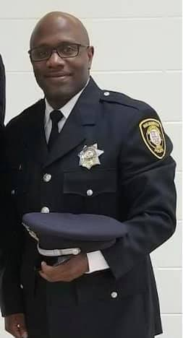
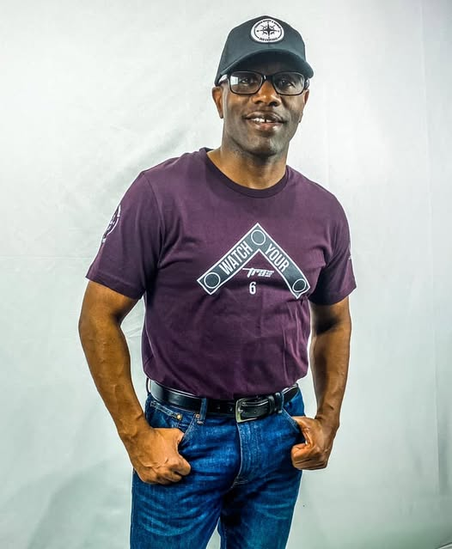
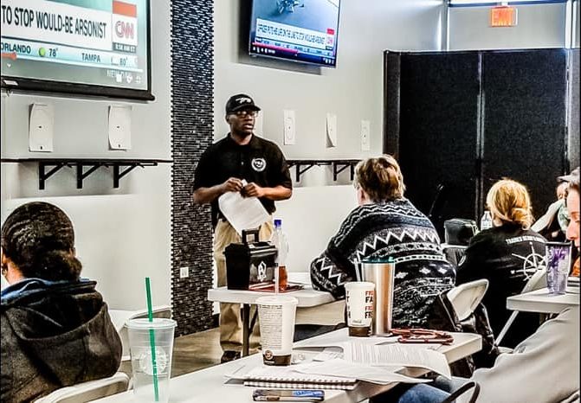
Excellence in Public Safety
Award #1: Sgt. Traneil Thomas
This Award is presented to honor and celebrate exceptional achievements and contributions in the realm of public safety. This award recognizes outstanding accomplishments in leadership, ethical conduct, and innovative strategies to law enforcement and community engagement. It acknowledges a commitment to safeguarding the public while upholding justice, demonstrating sound judgment, compassion, and responsiveness to the diverse needs and concerns of the community.

Slide 22
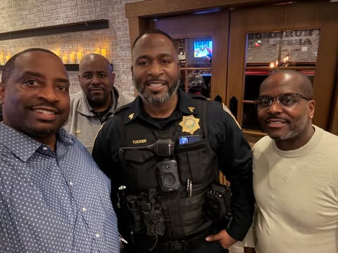
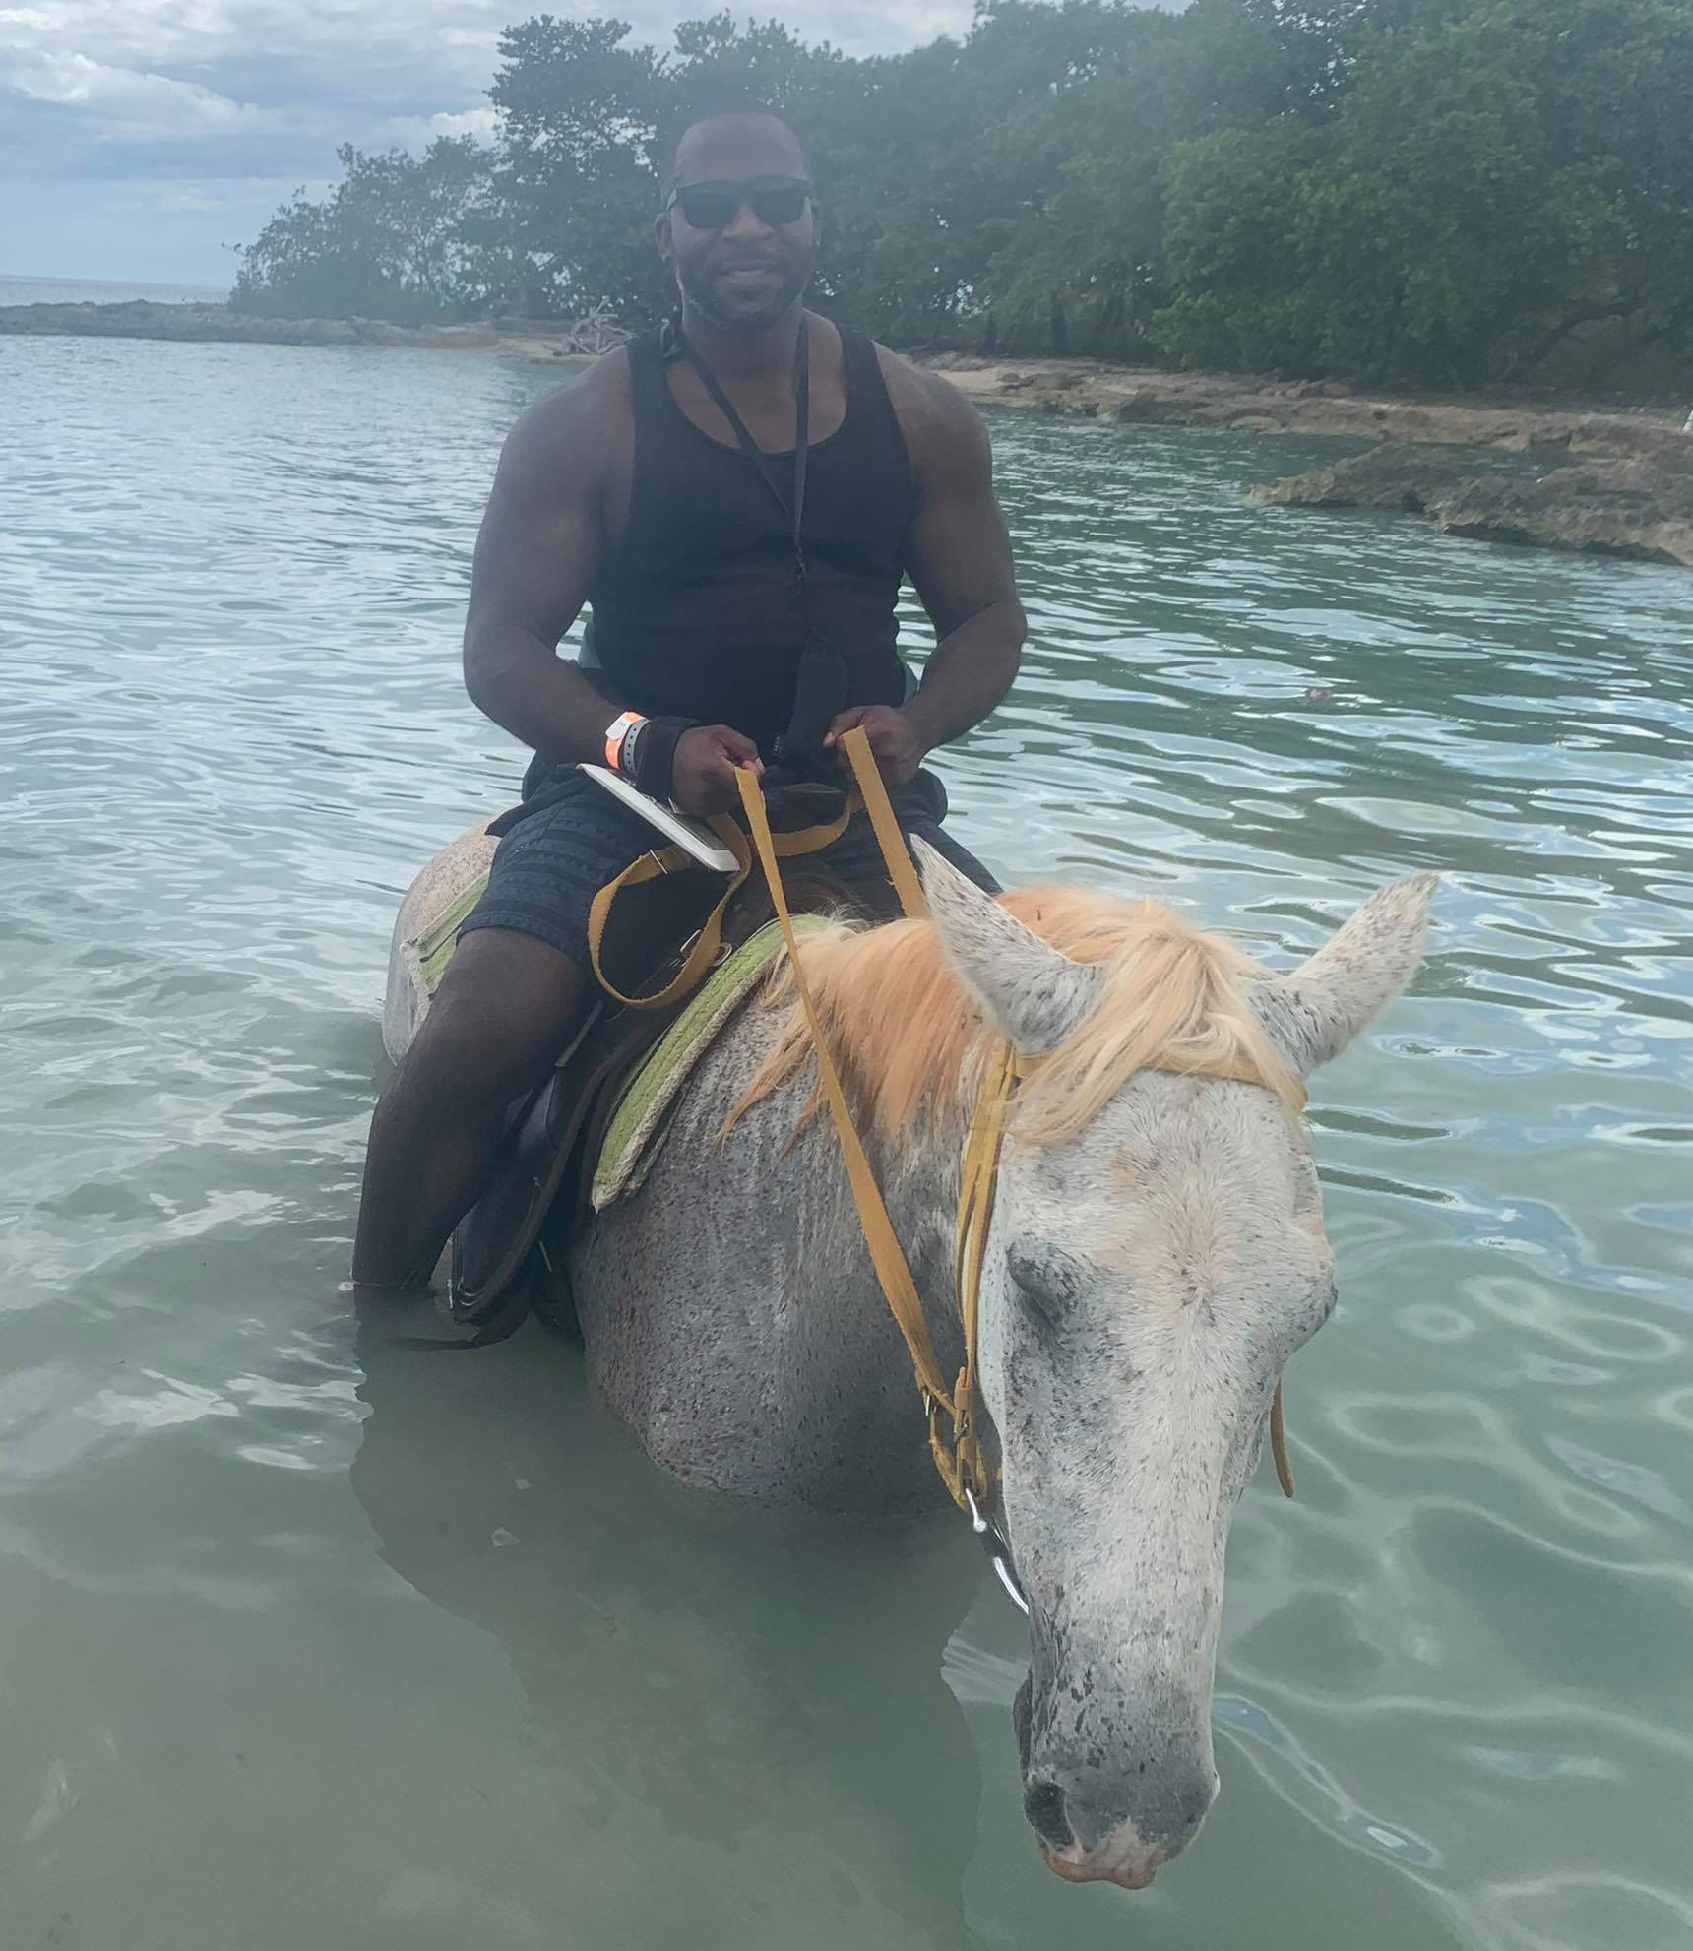
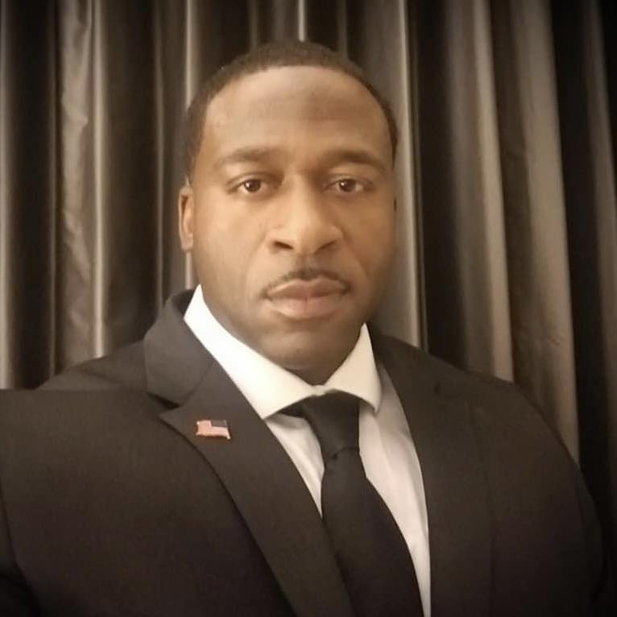
Excellence in Public Safety
Award #2: Sgt. Antonio Tucker
This Award is presented to honor and celebrate exceptional achievements and contributions in the realm of public safety. This award recognizes outstanding accomplishments in leadership, ethical conduct, and innovative strategies to law enforcement and community engagement. It acknowledges a commitment to safeguarding the public while upholding justice, demonstrating sound judgment, compassion, and responsiveness to the diverse needs and concerns of the community.

Slide 23
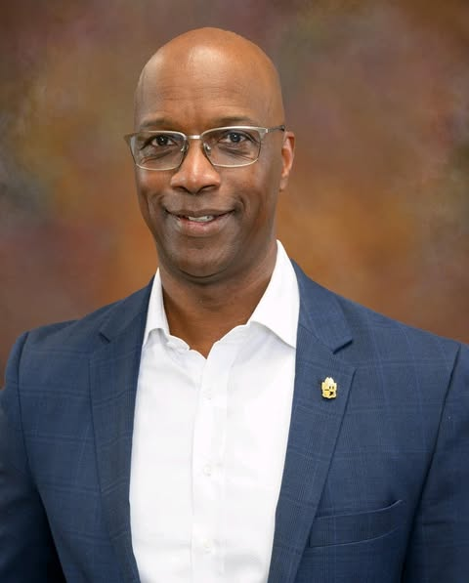

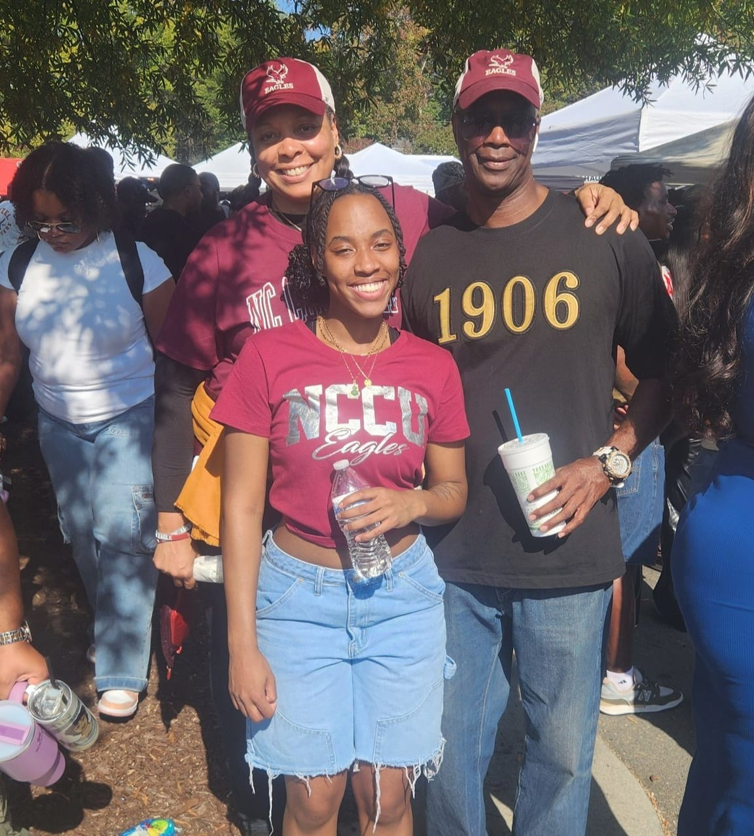
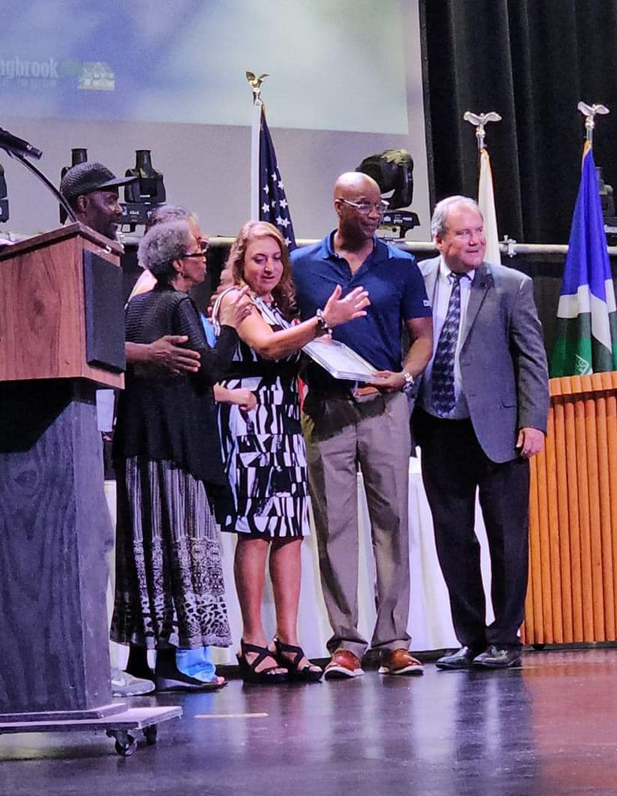
Ruby Lofton Community Impact Award
Award presented to: Bernard Winston
ACE is proud to honor founding member Ruby Lofton by establishing an award in her name. This award recognizes a community member who has made a significant impact through leadership, advocacy, and driving positive change through civic engagement over a sustained period of time. This distinguished individual embodies the spirit of service and deserves to be recognized and acknowledged for being a difference maker.

Slide 24
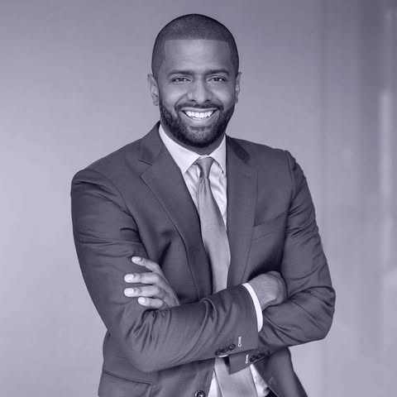
Keynote Address
Bakari Sellers
Two-time NY Times best-selling Author, Civil Rights Activist, Attorney, Entrepreneur, Legislator, and overall prolific voice of the culture.

Slide 25
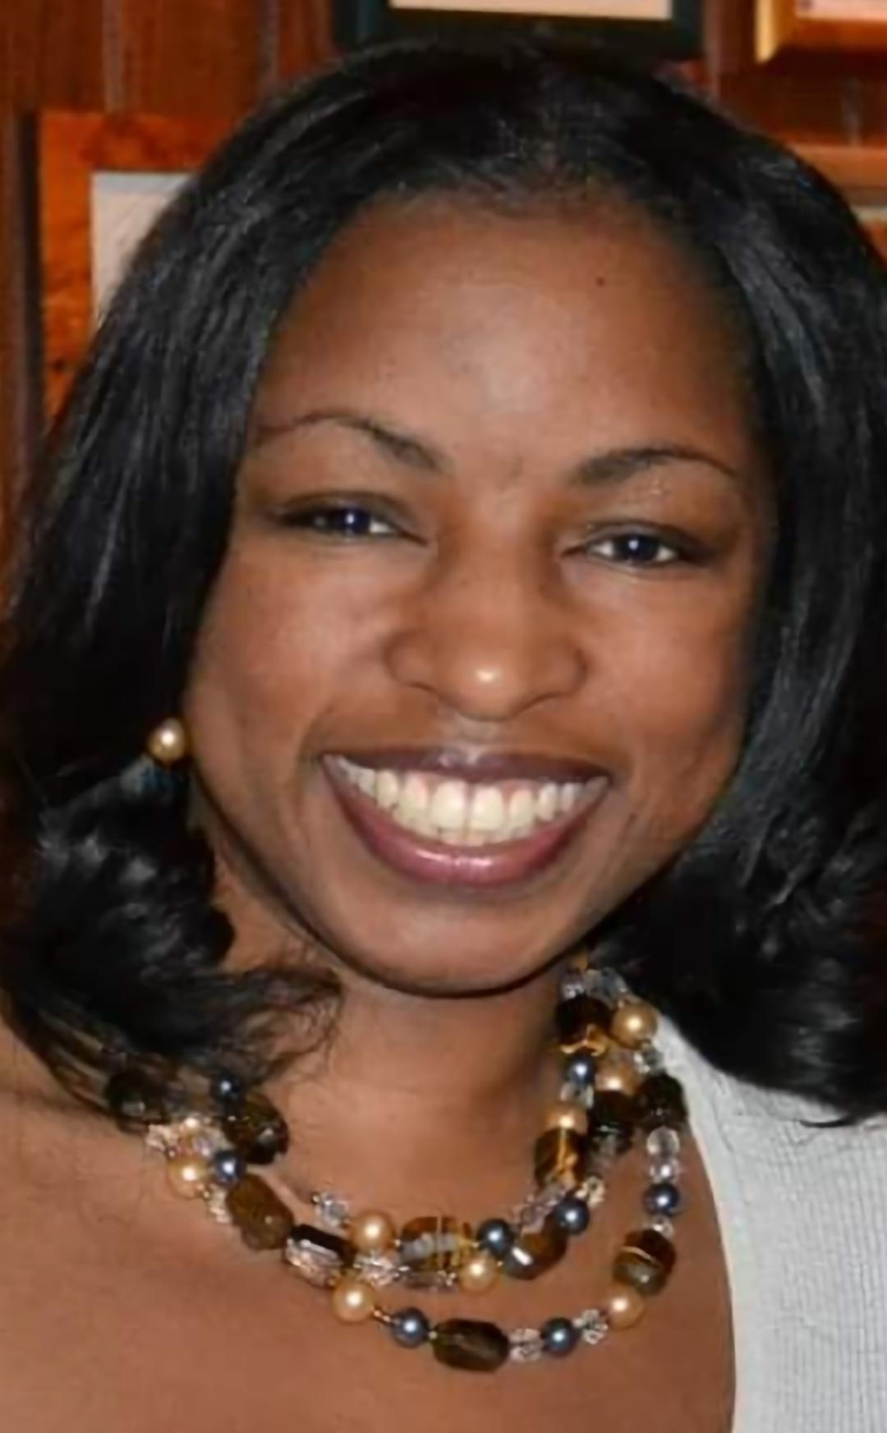
"The Case for ACE"
Invitation to New Members, Volunteers & Donors
Presented by Victoria Pipkin

Slide 26
"The Case for ACE"
HOW CAN I HELP?
3 DIFFERENT WAYS:
Donate
Become a Member
Volunteer
THANK YOU FOR YOUR SUPPORT!

Slide 27
Certificates of Appreciation
Bakari Sellers
Darlene Hill
Atiba Buchanan

Slide 28
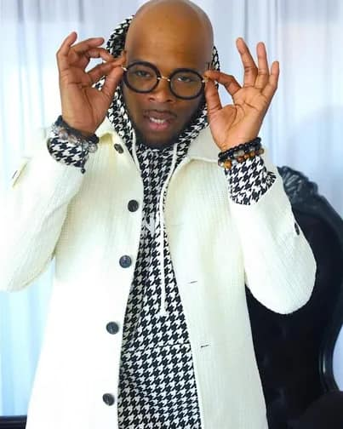
Performance
Dynamic R&B Singer Danny Boy

Slide 29
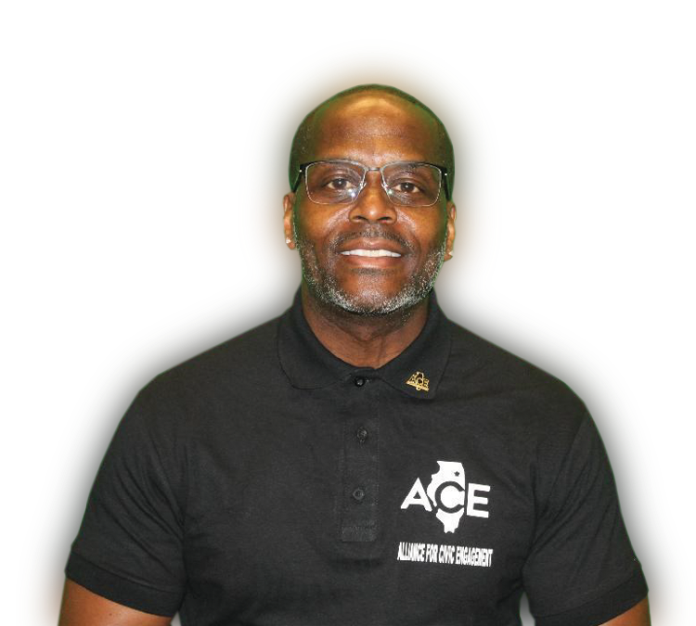
CLOSING REMARKS
ALEX McNULTY, ACE CHAIRMAN
Message Theme - "Stronger Together"!

Slide 30
Emcees WRAP-UP & FINAL REMARKS
Darlene Hill & Atiba Buchanan

